Slide 1

Market Capitalization and Sales Analysis of Top 500 Companies in India
An In-depth Financial Review

Slide 2
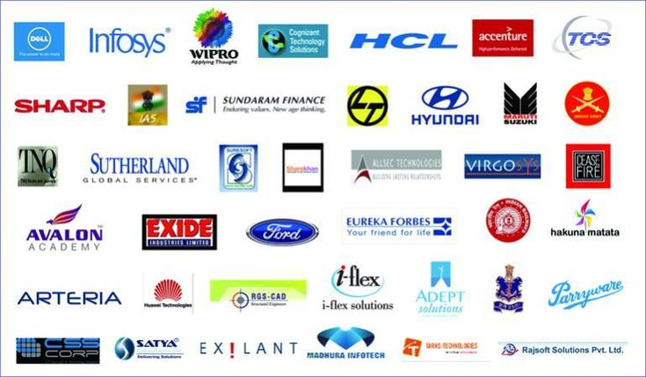

Introduction
Overview of the top companies in India by market capitalization and sales.
Importance of understanding financial metrics for strategic insights.

Slide 3
Top Companies by Market Capitalization

Slide 4
Top Companies by Quarterly Sales
COMPANY | QUATERLY SALES (in crores)
IOCL | 110666.9
Reliance Industries | 99810
Tata Motors | 74156.07
BPCL | 60616.36
HPCL | 57474.25

Slide 5
Descriptive Statistics
Market Capitalization
Quarterly Sales
Mean | 28043.86
Median | 9885.05
Standard Deviation | 71667.71
Minimum | 3017.07
Maximum | 583436.7
Mean | 3807.79
Median | 1137.17
Standard Deviation | 10312.19
Minimum | 0
Maximum | 110666.9

Slide 6
Quartile Analysis
Market
Capitalization
Quartiles
25th Percentile: ₹5,322.38
Median: ₹9,885.05
75th Percentile: ₹25,624.07
25th Percentile: ₹407.98
Median: ₹1,137.17
75th Percentile: ₹3,118.45
Quarterly
Sales
Quartiles

Slide 7
CONCLUSION
Market Leaders:
Reliance Industries, TCS, and HDFC Bank dominate in market capitalization, showing their sector leadership.
High Sales Performers:
IOCL and Reliance Industries lead in sales, reflecting strong revenue generation.
Diverse Distribution:
The quartile analysis reveals a wide range in market caps and sales, highlighting growth opportunities, especially for smaller companies.
Correlation Insight:
A moderate positive correlation exists between market cap and sales, indicating that higher sales generally align with larger market caps.
Strategic Focus:
Investing in top quartile companies offers stability, while the lower quartiles present high-growth potential.

